Slide 1
Digital Portfolio
STUDENT NAME: Abdul Salam.K.K
REGISTER NO AND NMID: 2422k2343
DEPARTMENT: BSc Computer Science
COLLEGE: JCT College of Arts and Science/Bharathiar UNIVERSITY

Slide 2
PROJECT TITLE Abdul Salam.K.K’s Port

Slide 3


AGENDA
Problem Statement
Project Overview
End Users
Tools and Technologies
Portfolio design and Layout
Features and Functionality
Results and Screenshots
Conclusion
Github Link
3/21/2024 Annual Review

Slide 4

PROBLEM STATEMENT
Need for a simple personal portfolio website.
Must showcase skills, projects, and contact info.
Should work in a single HTML file (HTML, CSS, JS only).

Slide 5

PROJECT OVERVIEW
A single-page portfolio using innerHTML.
Sections: Home, About, Projects, Contact.
Responsive, lightweight, and user-friendly.

Slide 6

WHO ARE THE END USERS?
Employers and recruiters.
Clients seeking freelance services.
Faculty evaluators and peers.

Slide 7

TOOLS AND TECHNIQUES
HTML5 → Structure.
CSS3 → Styling & responsive layout.
JavaScript (ES6) → Interactivity & local storage.
Browser + IDE for testing and development.

Slide 8
POTFOLIO DESIGN AND LAYOUT
Header with navigation.
Hero / About for intro & skills.
Projects in card layout.
Contact form + Footer.
8

Slide 9
FEATURES AND FUNCTIONALITY
Single-page navigation using hash links.
Responsive design with animations.
Contact form validation + localStorage.
Dynamic rendering with JavaScript.

Slide 10

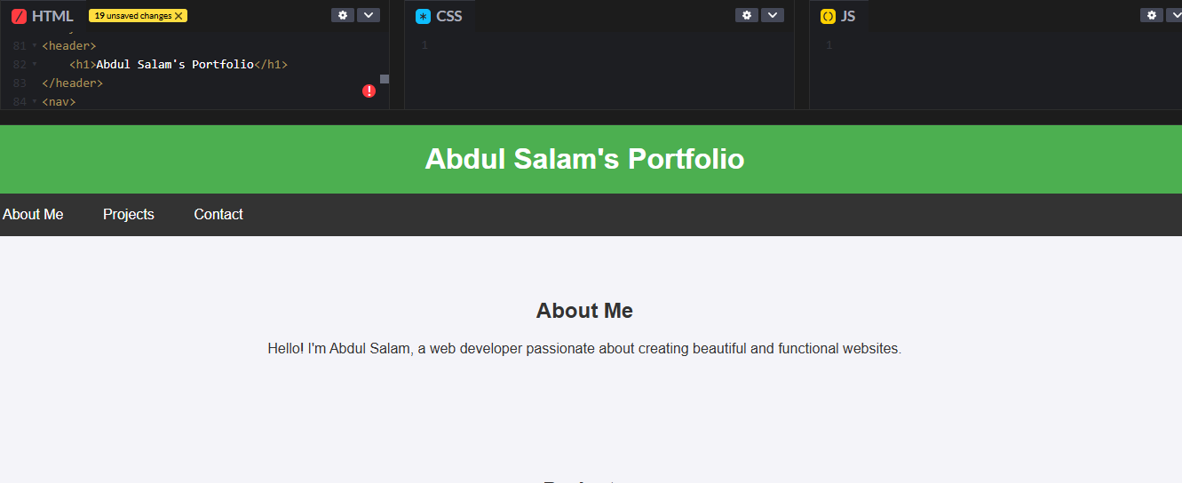
RESULTS AND SCREENSHOTS
3/21/2024 Annual Review
10

Slide 11
CONCLUSION
Demonstrates core web development skills.
Simple, portable, and effective portfolio solution.
Can be extended with backend or live project links.
11

